Slide 1


Spectral Variability of Protoplanetary Disks
Arizona Space Grant Consortium
April 22, 2017
Tempe, AZ
Laurin Gray
Advisor: Dr. Jarron Leisenring
Steward Observatory, University of Arizona
Notes:
I’m Laurin Gray, and I’m a sophomore majoring in Astronomy at the University of Arizona.
Today I’ll be talking about the spectra of protoplanetary disks as related to their composition, and how those compositions change over time.

Slide 2
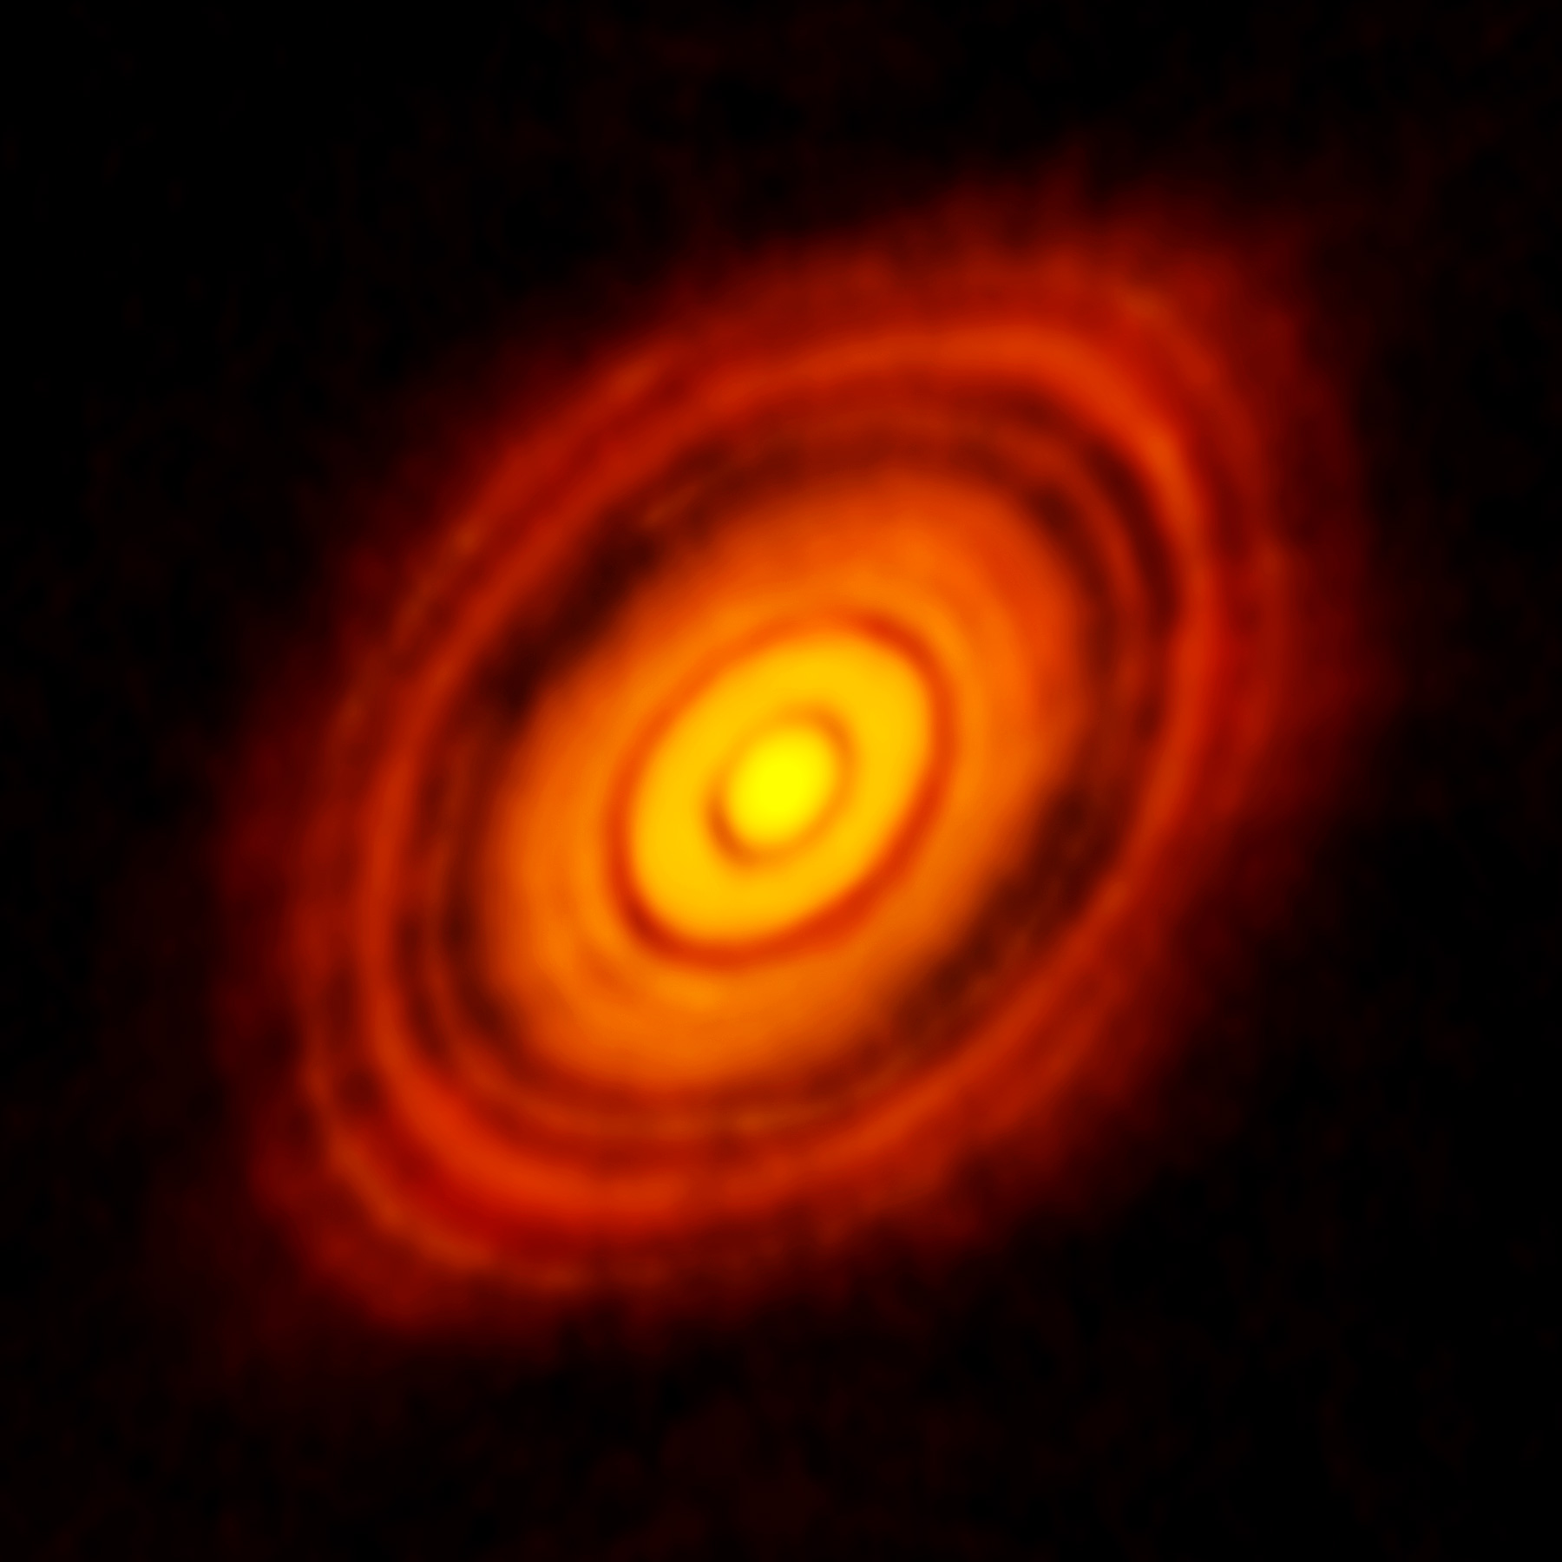
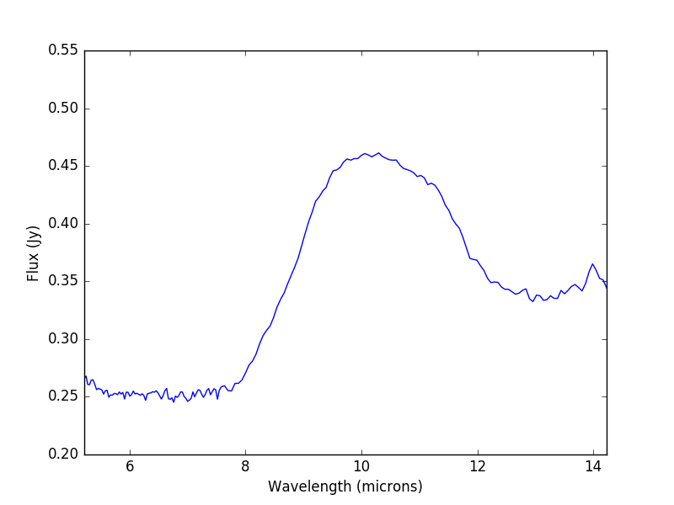
What is a Protoplanetary Disk?
Form around T Tauri stars
Made of dense gas and dust grains
Emission spectra of dust- 10 micron feature
Source: Alma
A raw spectrum for AATau
Notes:
Protoplanetary disks are rotating accretions of dense gas and dust that form around T-Tauri stars (and some other types, but we’re focusing on T Tauri). They’re believed to eventually evolve into planetary systems, hence the name!
Disks are heated by the star and so give off their own flux which can be observed separately from the star’s flux (because it’s much cooler). The flux of the disk tends to peak at about 10 microns, called the 10 micron feature.
But the disks are not made up of one type of dust grain, and each species has it’s own characteristics that affect the emission spectra. So how do we know what kinds of dust are present in a disk, and how much of each?
There are lots of dust species, but for our final results we just looked at the populations of three general groups- Amorphous Small grains, Amorphous Large grains, and Crystalline grains

Slide 3
Main Questions
What is the dust grain composition of the protoplanetary disks?
How do the compositions vary over time?
How does this influence the variation of the spectra over time?

Slide 4
Data Collection & Analysis
Data collection on Spitzer Space Telescope
Steps for analysis:
Plot each spectrum
Create a model
Run a Markov-Chain Monte Carlo simulation
Compare changes in dust populations to changes in flux
Notes:
Data Collection: Collected by Jarron Leisenring on Spitzer Space Telescope. Initial collection Feb. 2004, following observations every 6 months from 2005-2008. 12 star systems observed (list?), in the 5-14 μm range
Analysis:
Plot and save each spectrum (individually and together) to get an idea of what we’re looking at
Create model of a blackbody function based off these graphs with variables for grain populations
MCMC simulation
What it does: we have a LOT of different grains, and variables which depend on temperature, and we don’t know how much of each grain there is- no way we could guess at the correct values. A MCMC simulation runs over and over again, plugging all the different variable combinations into the model and comparing the resulting spectrum to the observed one as it learns which values are the most likely.
Our simulation identified the most likely percentages of dust grain groups (AmoSm, AmoLg, Cryst) for each observed spectrum/dataset
Comparison

Slide 5
Results
Composition: Discs primarily composed of amorphous small and large grains
Variation: Fairly small population fluctuations (<10%)
Influence on spectra: No clear correlations between changes in dust populations and overall flux
Notes:
5/9 disks had more AmoLg grains, 2/9 had more AmoSm, last two had an even split of AmoSm & AmoLg.; crystalline made up less than 5% of the dust population in 7/9 disks (one of the ones it didn’t is DQ Tau, which we’ll come back to in a second).
Populations fluctuated even over a timescale of a few days, but most of the time, they stayed within a 10% range over the complete observation period.
Fluxes also stayed fairly constant- all experienced less than 4% change at most from their average “flat” or “peak” values over the observation period.
Correlation: an increase in small grain pop. & an increase in flux (or vice versa). A change in the small grain population only coincided with a similar change in the fluxes about half the time, which isn’t enough to say that there’s a connection one way or the other.
When going over the data, I noticed that the variations in DQ Tau’s dust grain populations were really interesting though!!

Slide 6
What’s up with DQ Tau?
Noticed large changes in all 3 groups on 3/21/2007 and 10/9/2008
The DQ Tau system
Periodicity and matching observations
Why is this happening?
Notes:
(graph on next slide) Large drops in AmoSm and Cryst, large increases in AmoLg => implies that something happened on those dates
Okay so why does the period of the system matter? Well! It turns out that the two dates listed above have 569 days in between them, which correlates to almost exactly 36 complete orbits => thus, the stars were at basically the same position in their orbits on both days!
But how do we know that position was periastron (or close to it)? And why would that change the dust populations? My mentor and I theorized that when the stars are near each other, the smaller dust grains (AmoSm and Cryst) are more likely to be destroyed than the bigger ones; since our data was for the percentage of the disk, this meant that when the smaller populations decreased, the larger population appeared to “increase” (but it didn’t really).
I found a 1999 paper by Dr. Robert Mathieu that indicates the system brightens at periastron, and that implies an increased rate of matter falling on the stellar surface and heating of the region surrounding the stars (which also destroys some grains).
(remember to skip ahead two slides)

Slide 7
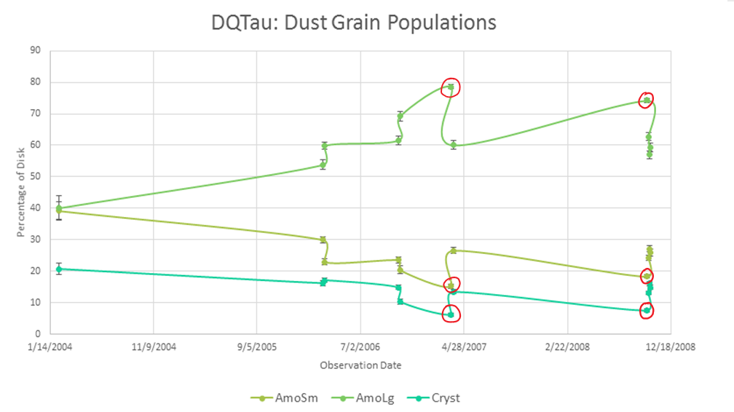
Notes:
I showed this to my mentor, and he told me that DQ Tau is a really interesting system (next slide)

Slide 8
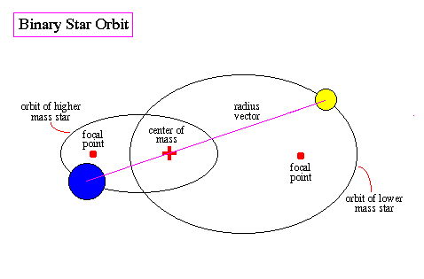
Source: University of Oregon
Notes:
DQ Tau is a binary star system with two similar mass stars in an elliptical orbit around a common center of mass. (This isn’t a diagram of DQ Tau’s orbit, just a general binary star system). Every 15.8 days they are very close together, which is called periastron. (remember to go back to the text slide)

Slide 9
Further Investigation and Limitations
Only observed areas of the disks illuminated by the star
Original data did not include observations of the stars themselves- could be an idea for a future study
Notes:
In this model, we assume that we are observing the entire disk. If we aren’t seeing the whole thing, then the model expects the disks to have a fairly uniform mix of grains (i.e. no heavy grains all clumped together towards the outer edges of the disk). Therefore, we might not have a clear picture of the entire disk.
Second, we didn’t have information on what the stars themselves were doing at the observation times. Could the dust populations be fluctuating due to stellar activity without greatly affecting the flux of the disks, since those stayed fairly constant? Like I mentioned, heating the disk could destroy some smaller grains, but then illuminate further portions of the disk, possibly evening out the total flux of the disk.

Slide 10
Acknowledgements
Dr. Jarron Leisenring
Steward Observatory/University of Arizona Astronomy Department
Arizona Space Grant Consortium

Slide 11
Thank You

